Slide 1

Bike Sharing Demand Analysis Project
A comprehensive Excel-based analysis to study how weather, time, and holidays impact bike rentals.
Includes data merging, cleaning, visualization, and automation.
By Dhruv Singh

Slide 2
Project Overview
Objective: Understand how environmental and temporal factors affect bike rentals.
Tools Used: Microsoft Excel, Power Query, VBA Macros, AI Forecasting.
Outcome: Data-driven insights for optimizing operations and forecasting demand.

Slide 3
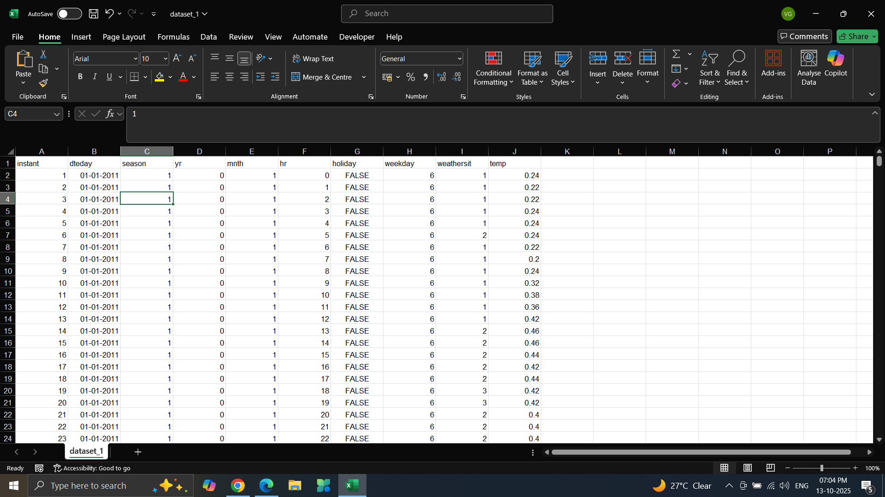
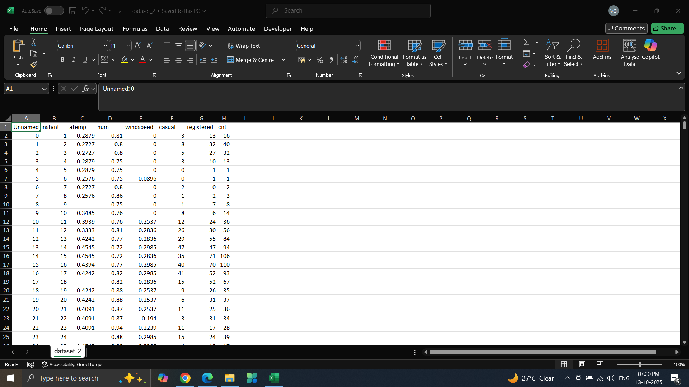
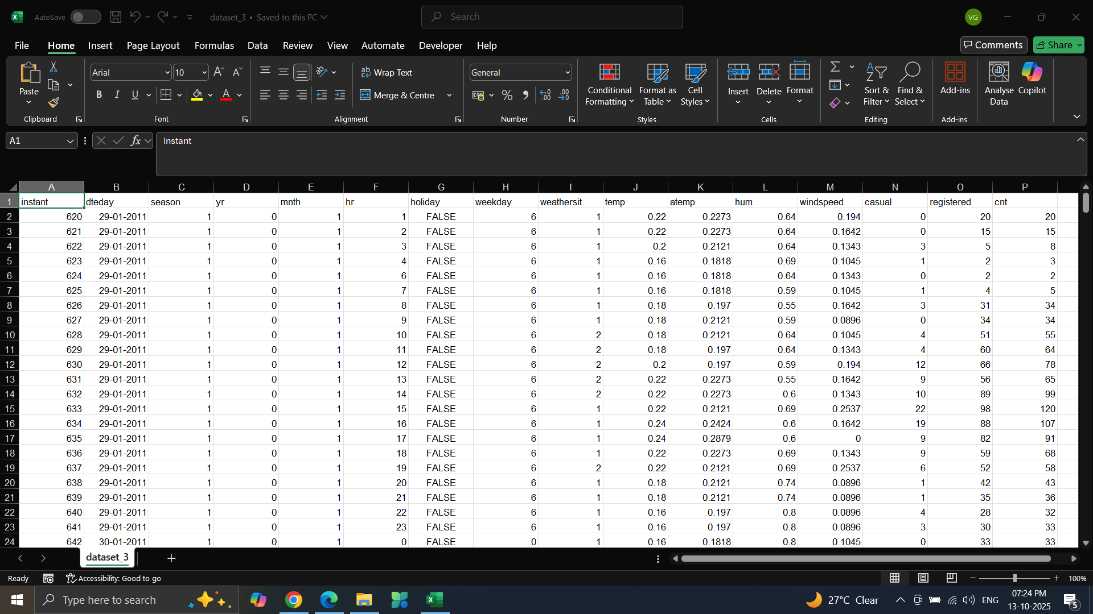
Datasets Used
• Dataset 1 – Bike rental details (hourly/daily data)
• Dataset 2 – Weather information
• Dataset 3 – User demographics and usage types
All three datasets were merged using common keys: instant, dteday, hr.
Dataset 1
Dataset 2
Dataset 3

Slide 4
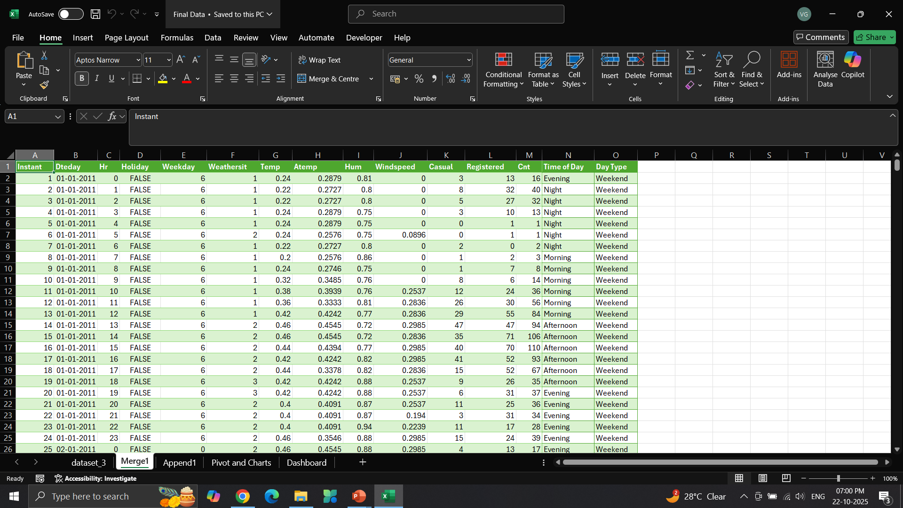
Data Cleaning and Preparation
Imported and merged datasets using Power Query and VLOOKUP.
Removed duplicates and standardized data types.
Handled missing and inconsistent values.
Created new derived columns for analysis (e.g.,Time of Day,weekday/weekend classification).

Slide 5
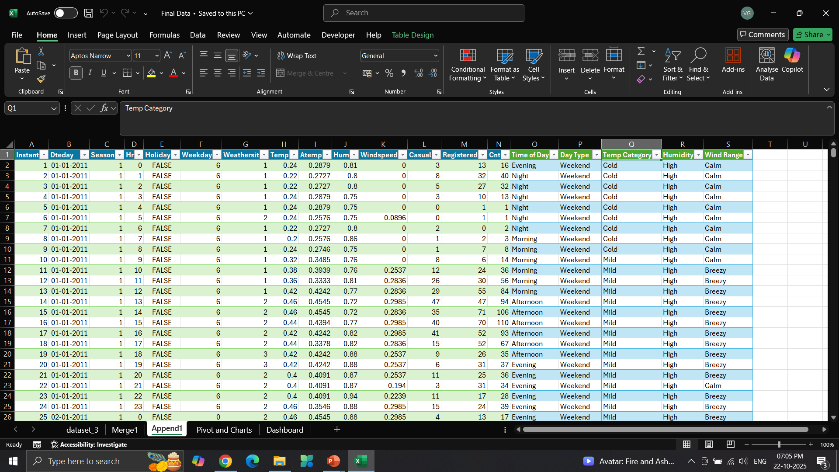
Conditional Logic and Lookup Functions
Applied IF statements to categorize rentals (Humidity Type, Temperature Category,
Wind Range).
Used INDEX, MATCH, and VLOOKUP for relational lookups.

Slide 6
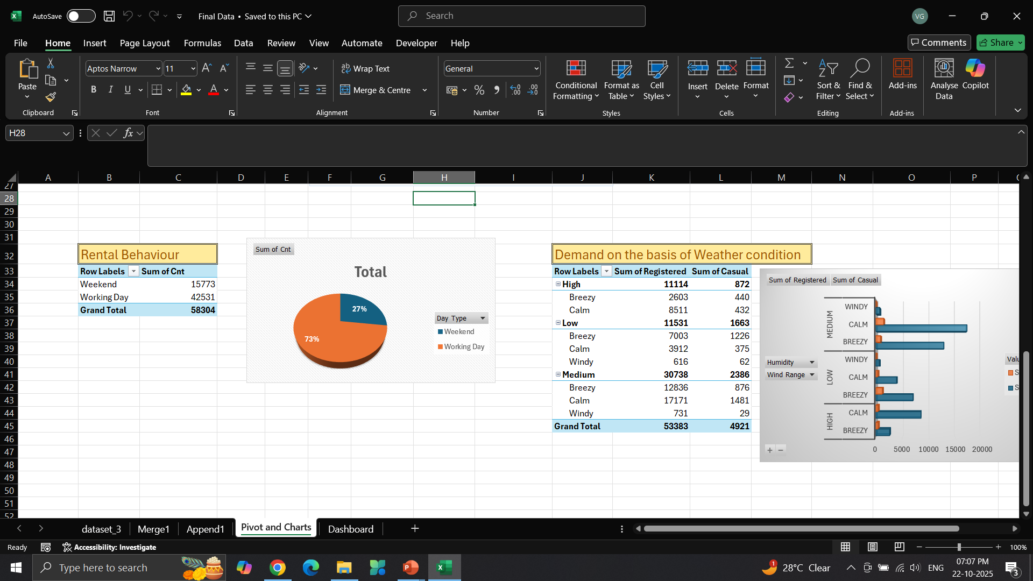
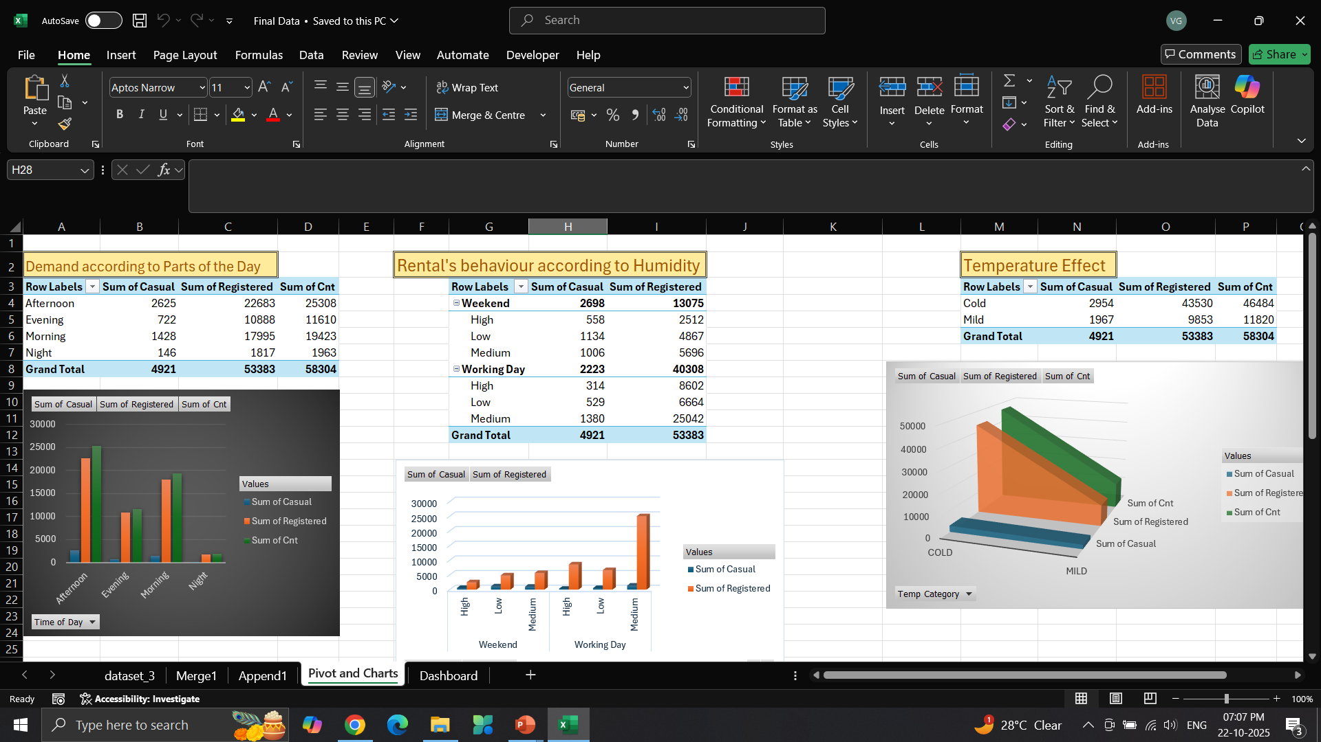
Advanced Data Analysis
Built Pivot Tables and Charts for summary analysis.
Used COUNTIF, SUMIF, STDEV, and CORREL functions to explore relationships.
Identified demand peaks by hour, weather, and user type.

Slide 7
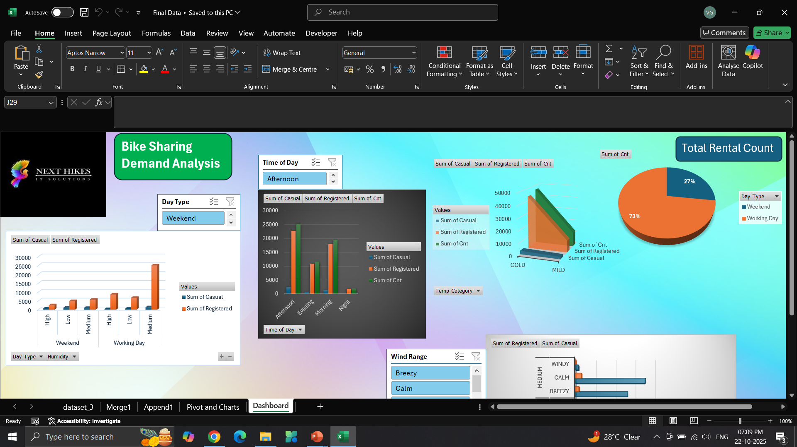
Data Visualization & Dashboards
Designed interactive dashboards with slicers and timelines.
Included trend analysis using Forecast Sheets.
Visualized performance with line charts, heatmaps, and funnel charts.

Slide 8
Conclusion & Learnings
Strengthened skills in Excel automation, data visualization, and analytics.
Demonstrated complete data lifecycle handling — from raw data to AI-powered insights.
Enhanced decision-making efficiency through automation.

Slide 9
Thank You

